Slide 1
Having Fun with T-SQL Part -4
Md. Khairul Alam MCTS, MCPD, CSM
Software Engineer, AML
DataSoft Systems Bangladesh Limited

Slide 2
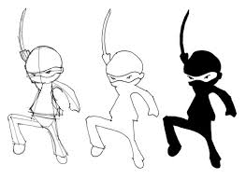
Trigger
Novice To Ninja

Slide 3
Trigger Basics
SQL Server triggers are special stored procedures attached to table events. They can’t be executed directly, but fi re only in response to an INSERT, UPDATE, or DELETE event on a table.
Users can’t bypass a trigger; and unless the trigger sends a message to the client, the end user is unaware of its actions.
Triggers may be created for the three data-modifi cation commands: INSERT, UPDATE, and DELETE.

Slide 4
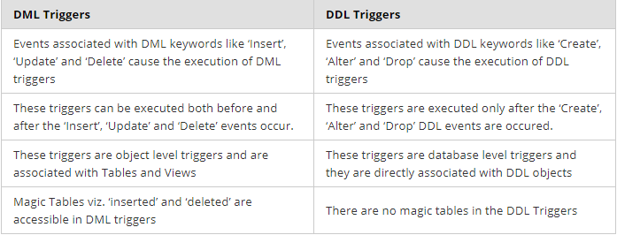
DDL vs DML Trigger
DML triggers execute when a user tries to modify data through a data manipulation language (DML) event. DML events are INSERT, UPDATE, or DELETE statements on a table or view. DDL trigger is executed when a database object is created, altered or dropped from the database.

Slide 5
Types of DML Triggers
After Trigger (using FOR/AFTER CLAUSE)
This trigger fires after SQL Server completes the execution of the action successfully that fired it.
Example :If you insert record/row in a table then the trigger associated with the insert event on this table will fire only after the row passes all the checks, such as primary key, rules, and constraints. If the record/row insertion fails, SQL Server will not fire the After Trigger.
AFTER triggers are useful for the following:
■ Complex data validation or business rules
■ Writing data-audit trails
■ Maintaining modification tracking columns
■ Enforcing custom referential-integrity or cascading actions

Slide 6
Types of DML Triggers
Instead of Trigger (using INSTEAD OF CLAUSE)
This trigger fires before SQL Server starts the execution of the action that fired it. This is much more different from the AFTER trigger, which fires after the action that caused it to fire. We can have an INSTEAD OF insert/update/delete trigger on a table that successfully executed but does not include the actual insert/update/delete to the table.
Example :If you insert record/row in a table then the trigger associated with the insert event on this table will fire before the row passes all the checks, such as primary key, rules, and constraints. If the record/row insertion fails, SQL Server will fire the Instead of Trigger.

Slide 7
Trigger Limitations
Given their nature (code attached to tables), DML triggers have a few limitations. The following SQL commands are not permitted within a trigger:
■ CREATE, ALTER, or DROP database
■ RECONFIGURE
■ RESTORE database or log

Slide 8
DDL Trigger
DDL triggers are useful for auditing server-level and database changes. They can easily pinpoint which objects were changed, who changed them, and even undo unauthorized changes.
DDL triggers fire as the result of some server-level or database schema–level event — typically data definition language (DDL) code — a CREATE, ALTER, or DROP statement. Where DML triggers respond to data changes, DDL triggers respond to schema changes.

Slide 9
Types of DDL Triggers
Transact-SQL DDL Trigger: A special type of Transact-SQL stored procedure that executes one or more Transact-SQL statements in response to a server-scoped or database-scoped event. For example, a DDL Trigger may fire if a statement such as ALTER SERVER CONFIGURATION is executed or if a table is deleted by using DROP TABLE
CLR DDL Trigger: Instead of executing a Transact-SQL stored procedure, a CLR trigger executes one or more methods written in managed code that are members of an assembly created in the .NET Framework and uploaded in SQL Server.

Slide 10
Why DDL Trigger ?
Use DDL triggers when you want to do the following:
Prevent certain changes to your database schema.
Have something occur in the database in response to a change in your database schema.
Record changes or events in the database schema.

Slide 11
